Slide 1
Blockchain-Powered Proxy Re-Encryption: Safeguarding Data Sharing in the Internet of Things Batch No:4 Students: Project Guide: S.MD. Mateen Hussain. S.V.S.Ganga Devi. A. Shamini. S. Faizal.

Slide 2
ABSTRACT
The IoT's data-sharing in cloud computing is powerful, yet security concerns persist due to potential misuse and resulting damages.
In this article, we propose a proxy re-encryption approach to secure data sharing in cloud environments.
Owners encrypt data for the cloud with identity-based encryption, using proxy re-encryption for user access. Edge devices serve as proxy servers for resource-constrained IoT devices.

Slide 3
INTRODUCTION
Traditional encryption schemes have complex key management protocols, limiting their suitability for data sharing.
Proxy re-encryption (PRE), introduced by Blaze et al., allows a proxy to transform a file encrypted under a delegator’s public key for a delegatee.
In this scheme, the data owner (delegator) can send encrypted messages to the user (delegate) temporarily without disclosing the secret key.
Re-encryption keys are generated by the data owner or a trusted third party.

Slide 4
LITERATURE SURVEY
TITLE | AUTHOR | Pros | Cons
A Proxy Re-Encryption Approach to Secure Data Sharing in the Internet of Things Based on Blockchain | Kwame Opuni-Boachie Obour Agyekum | Using Proxy Server | Less Accuracy
An Authenticated Keyword Searchable Conditional Proxy Re-encryption Scheme in Cloud Services | Ashutosh Swarnakar | Flexibility and Customization. Cloud Service Integration | Potential for Misuse Key Management Challenges
Clock-Based Proxy Re-encryption Scheme in Unreliable Clouds | Guojun Wang | Temporal Access Control Mitigation of Replay Attacks | Resource Overhead Synchronization Challenges

Slide 5
EXISTING SYSTEM
Identity-Based Cryptography Encryption (IBCE) allows a semi-trusted proxy to transform an encryption under an access policy into an encryption under a new access policy, without revealing any information about the underlying message.
Healthcare needs diverse data views with varied access. Ciphertext Policy-Attribute-based Encryption (CP-ABE) ensures one-to-many access control using attribute-based policies on ciphertext.

Slide 6
DISADVANTAGES
Compatibility Issues
Unblock Websites

Slide 7
PROPOSED SYSTEM
We propose a proxy re-encryption approach to secure data sharing in cloud environments. Data owners can outsource their encrypted data to the cloud using identity-based encryption, while proxy re-encryption construction will grant legitimate users access.
With the Internet of Things devices being resource-constrained, an edge device acts as a proxy server to handle intensive computations.

Slide 8
ADVANTAGES
No set up costs or complex system to operate
Provide a relatively long float

Slide 9
ALGORITHM
ABE
Attribute-based encryption (ABE) can be used for log encryption. Instead of encrypting each part of a log with the keys of all recipients, it is possible to encrypt the log only with attributes which match recipients' attributes.

Slide 10
Cipher Text
Cipher text is also known as encrypted or encoded information because it contains a form of the original plaintext that is unreadable by a human or computer without the proper cipher to decrypt it. Decryption, the inverse of encryption, is the process of turning cipher text into readable plaintext.

Slide 11
MODULES
In this project has four modules;
Data user
Trust authority
Data owner
proxy server
Cloud service provider

Slide 12
DATA OWNER
Register the account with the basic information
After authorize user can login the account with correct username and password
Upload the file with the encryption format.
View user request and Make a request for re-encryption
View the status and Re-Encrypted the key
Logout

Slide 13
TRUST AUTHORITY
TA can login the account with the correct Credentials
View users and owners authorize them
View user Download request and Send the Key
Logout

Slide 14
PROXY SERVER
Login the account with the correct username and password
View all uploaded files
View Re-Encryption request and Send the Responses
View all downloaded files
Graph
Logout

Slide 15
CLOUD SERVICE PROVIDER
Login the account with the correct username and password
View all uploaded files
View all downloaded files
Graph
Logout

Slide 16
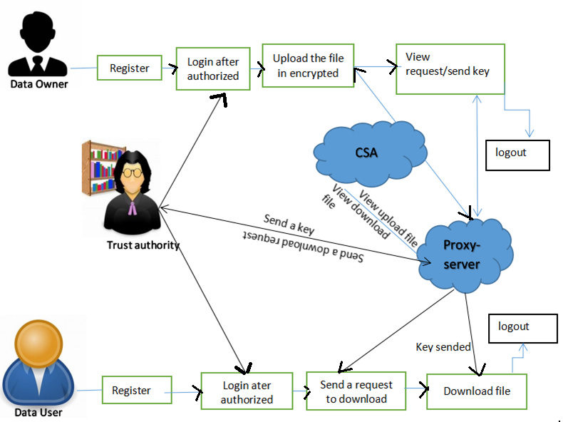
SYSTEM ARCHITECTURE

Slide 17
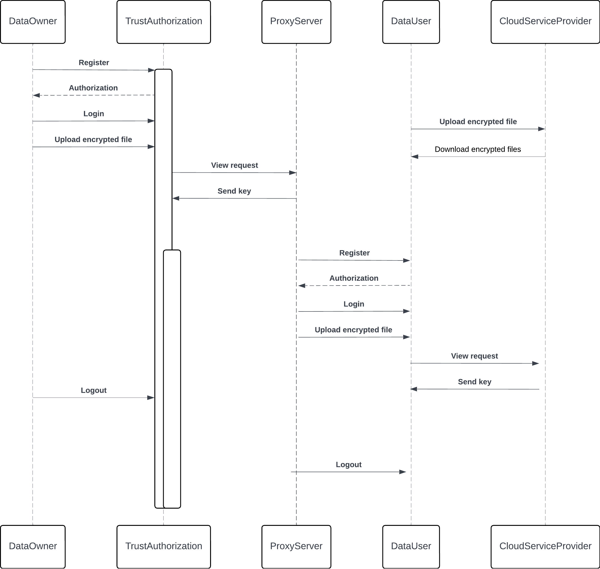
UML DIAGRAMS
SEQUENCE
DIAGRAMS

Slide 18
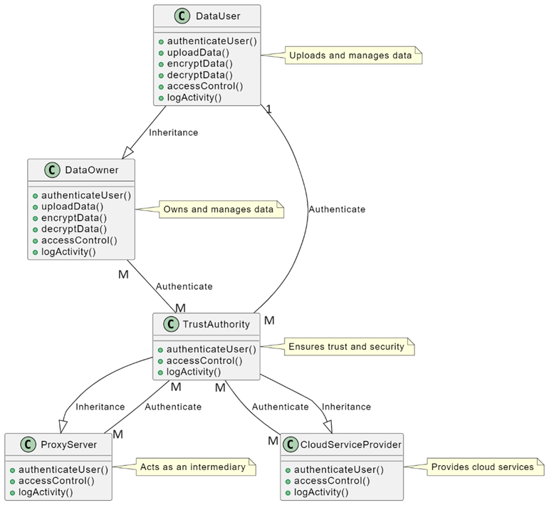

Slide 19
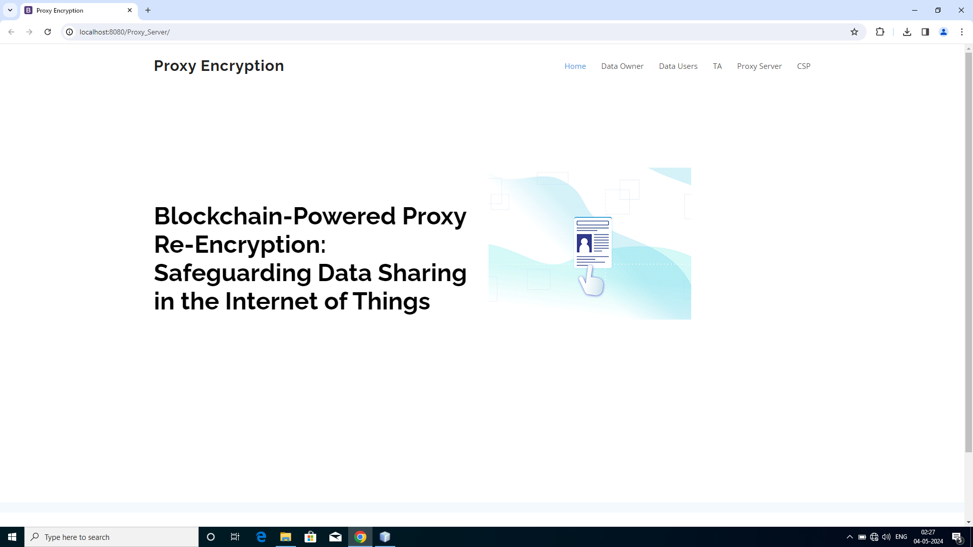
IMPLEMENTATION

Slide 20
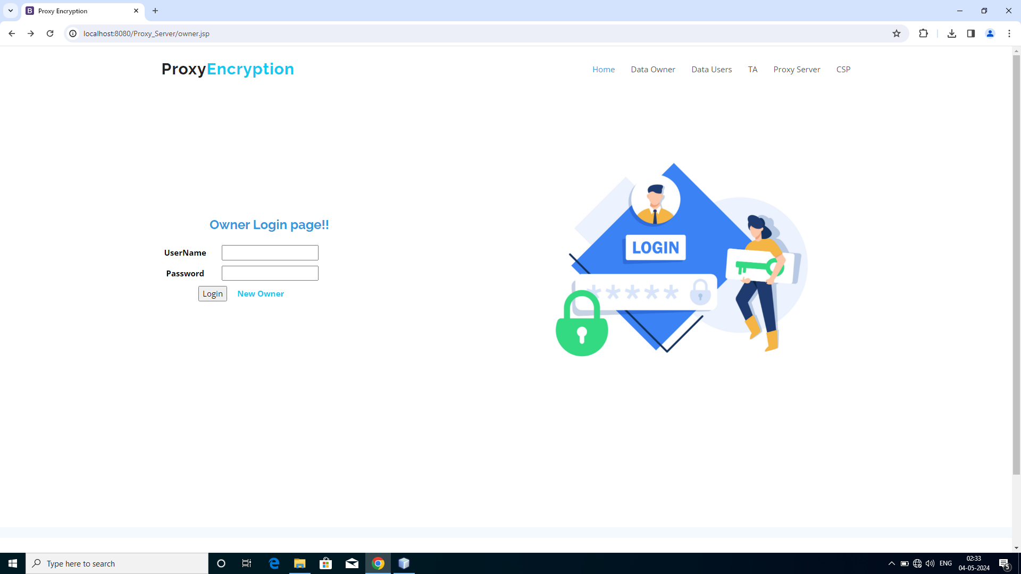
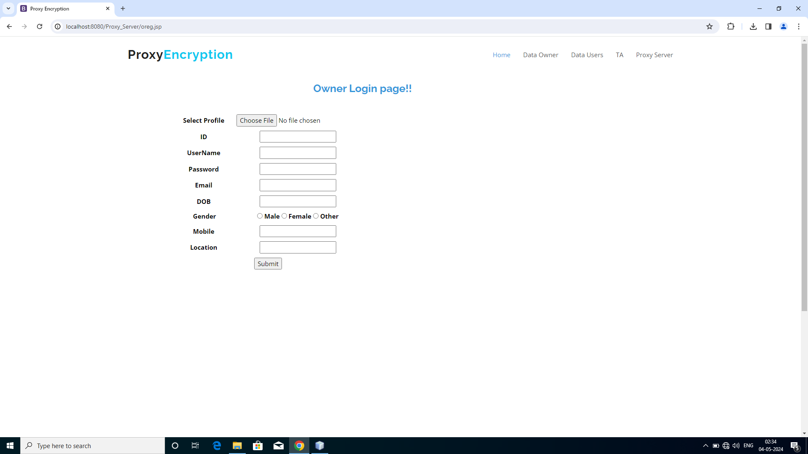

Slide 21
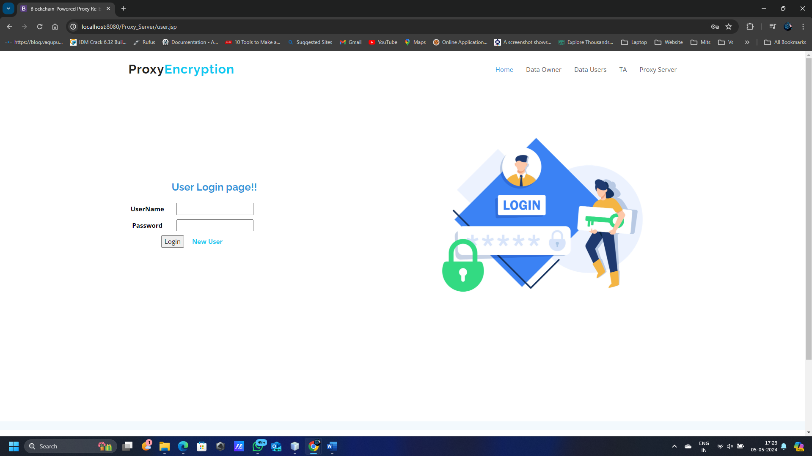
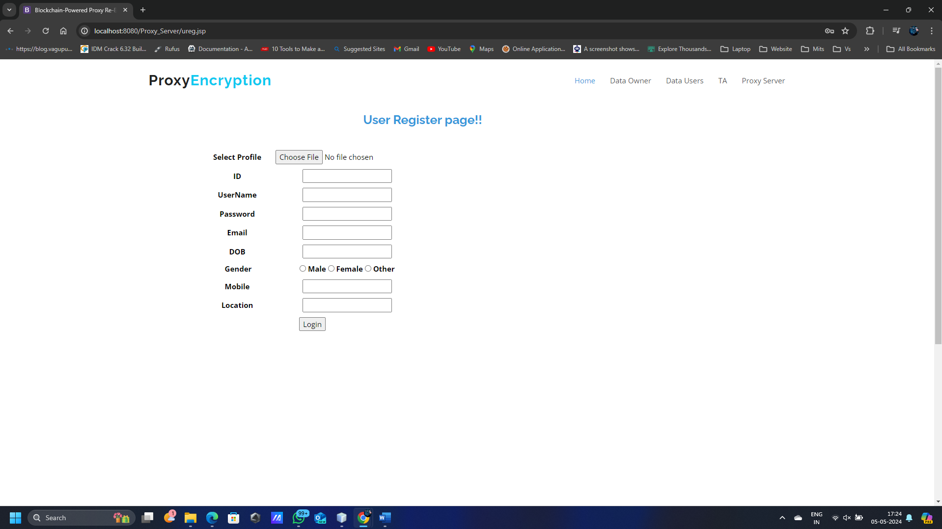

Slide 22



Slide 23

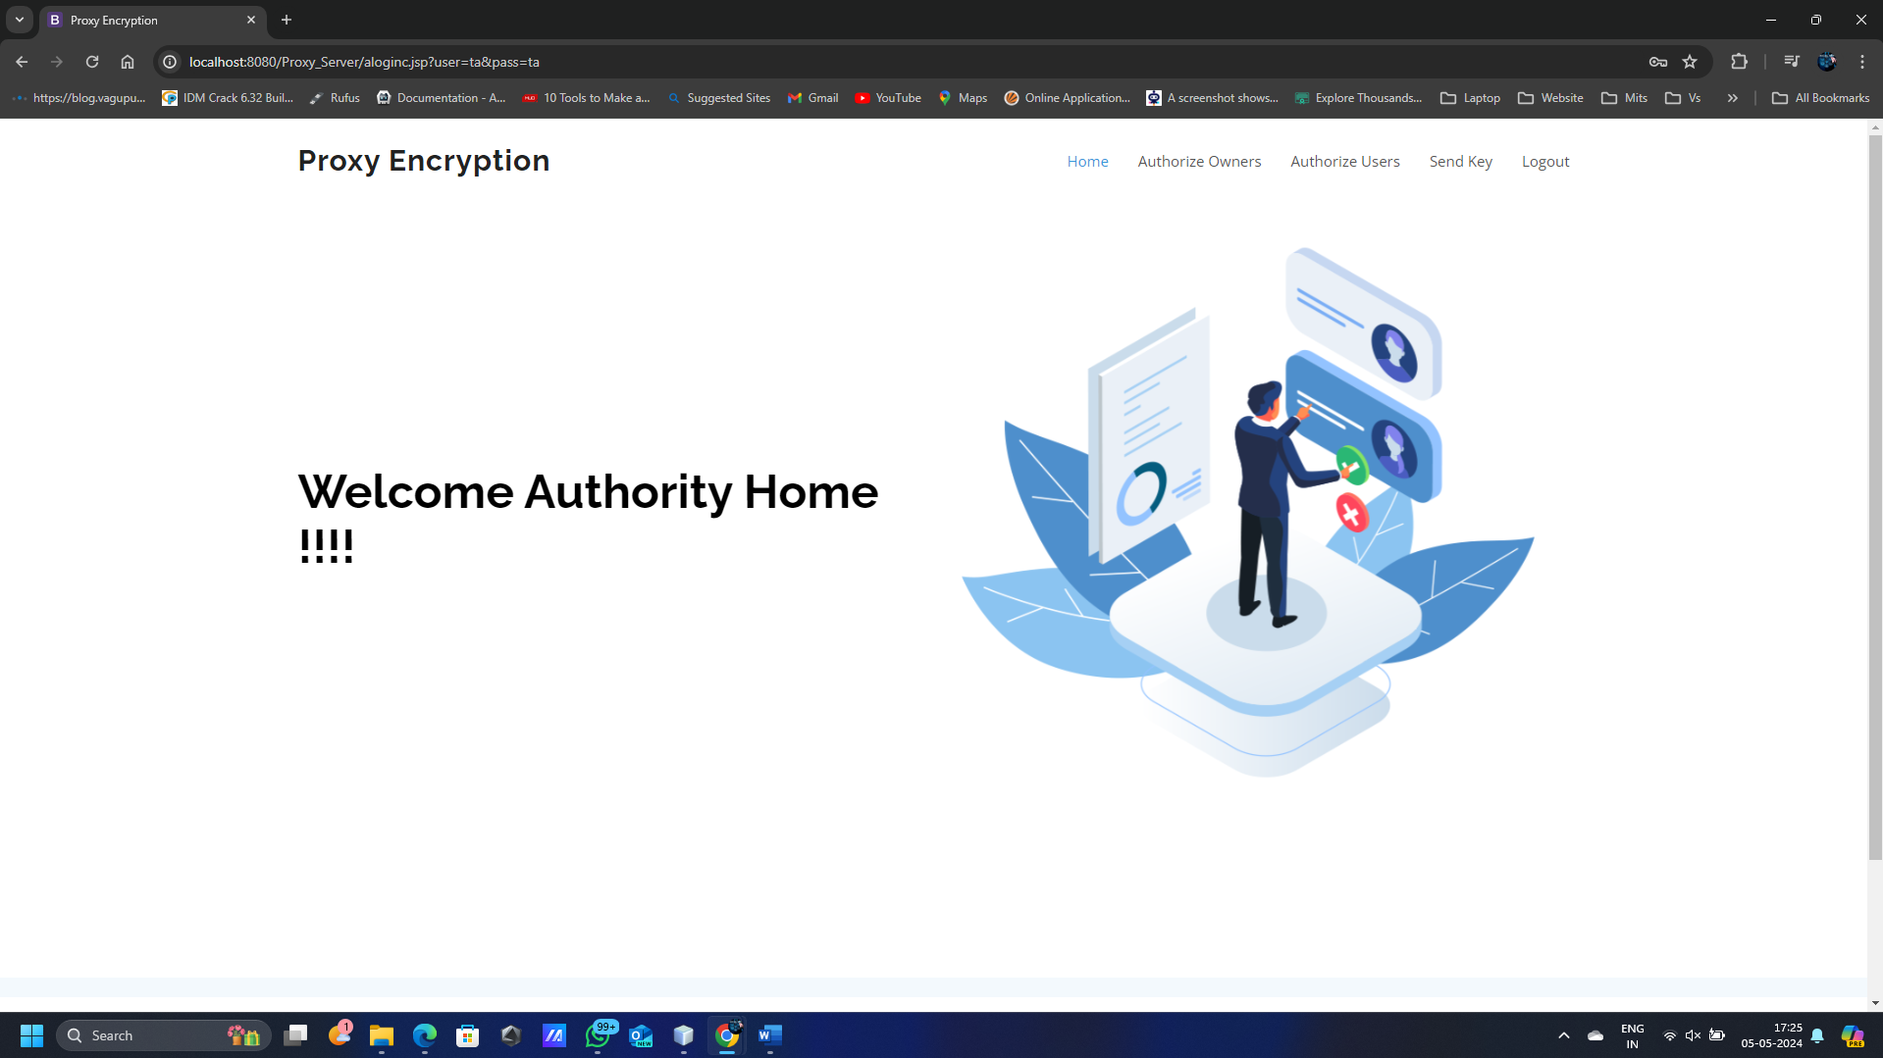

Slide 24
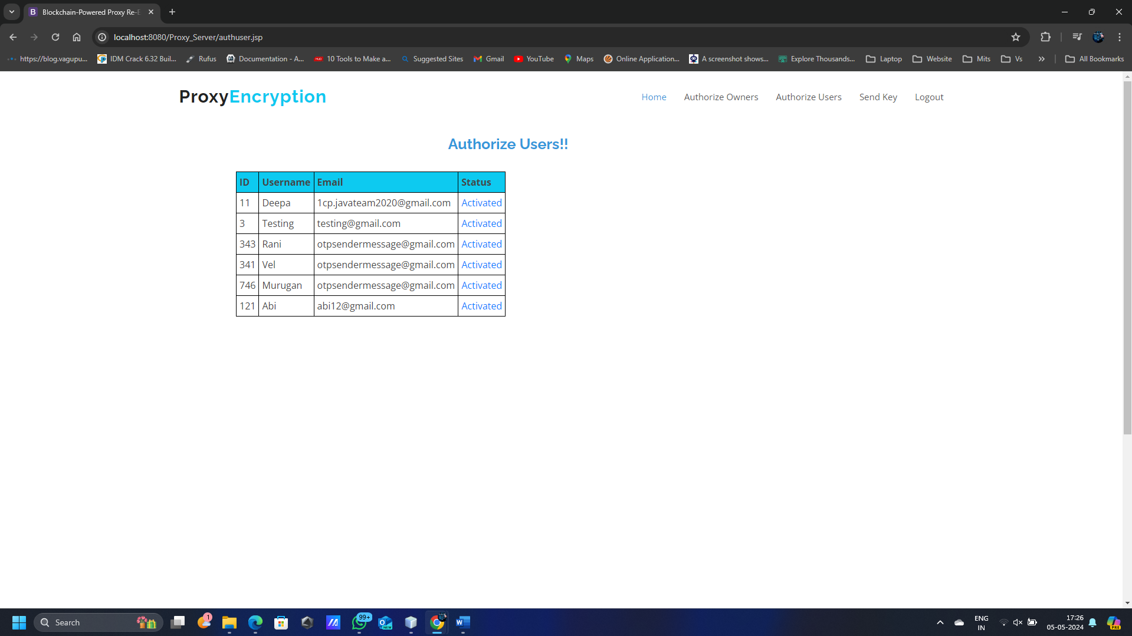
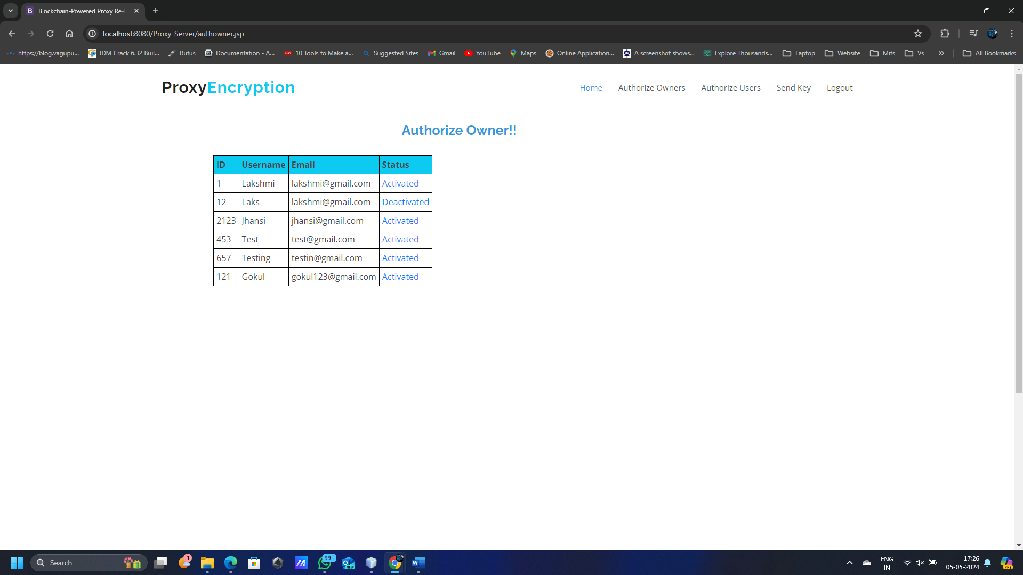

Slide 25
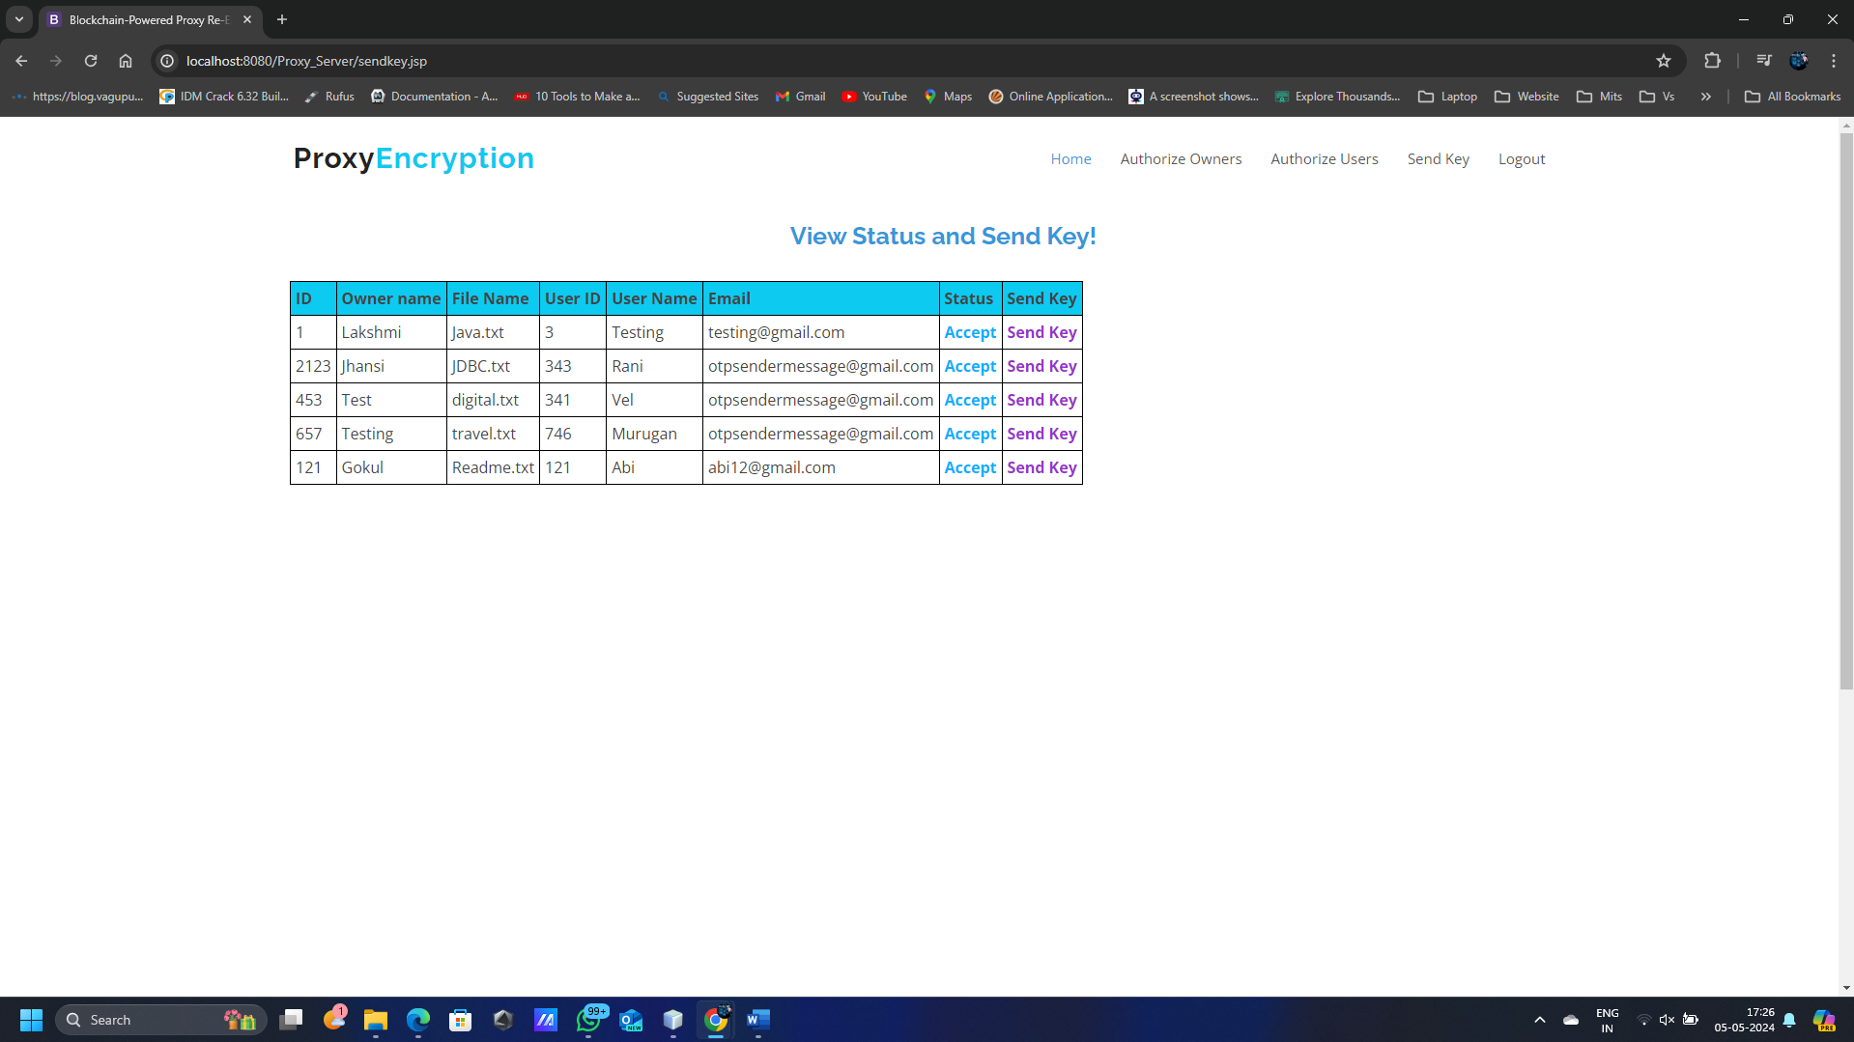
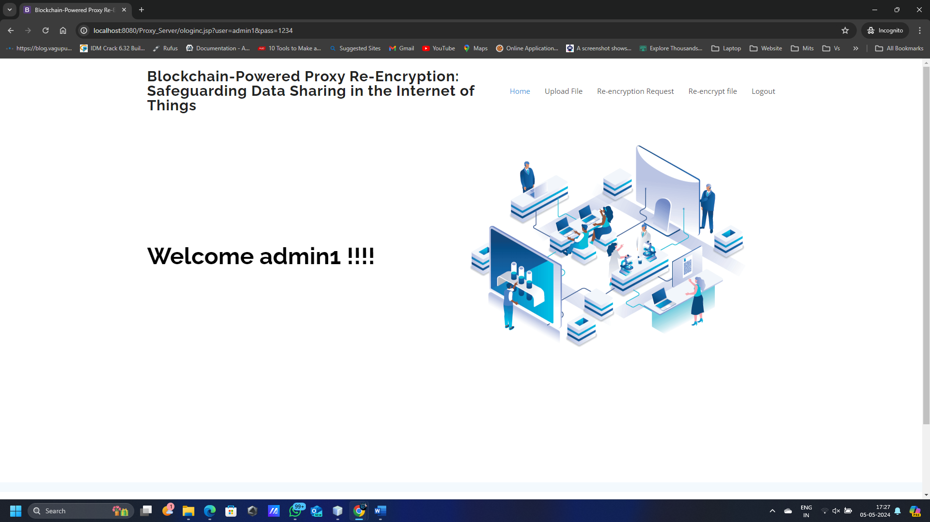

Slide 26
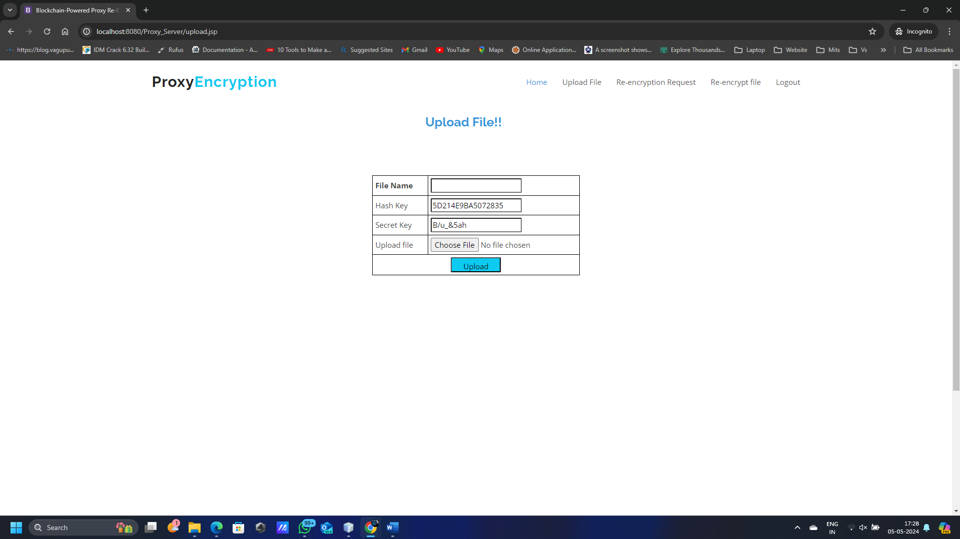
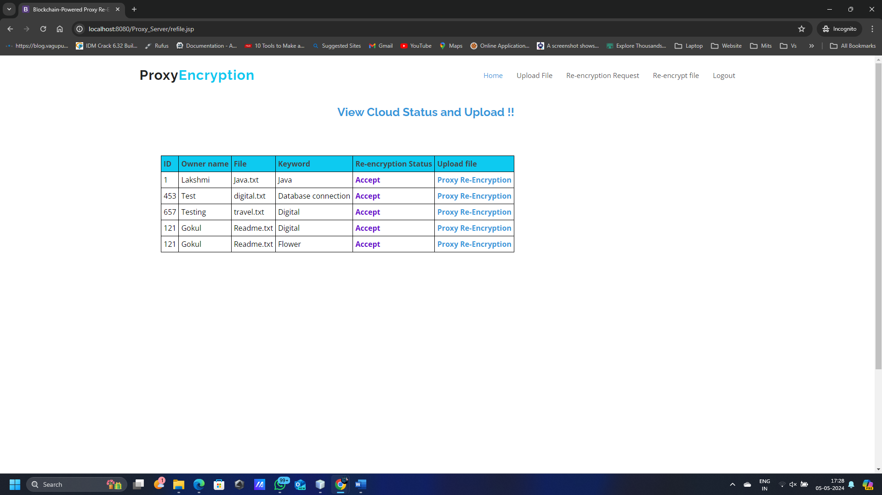

Slide 27
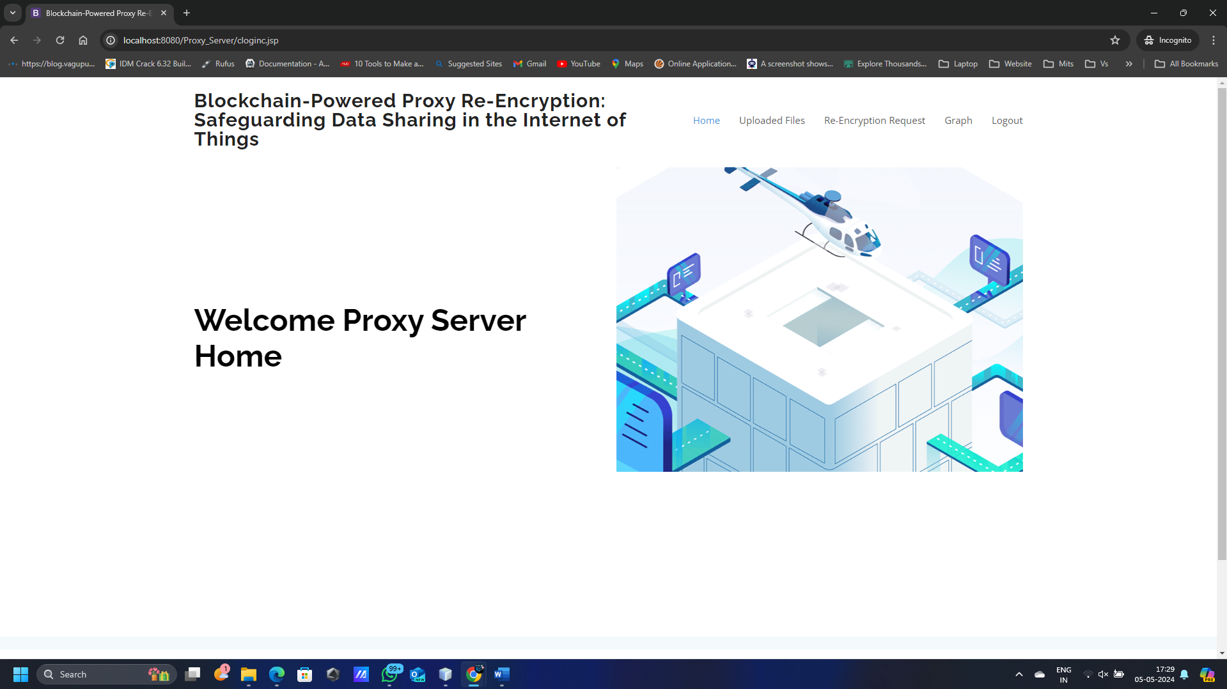
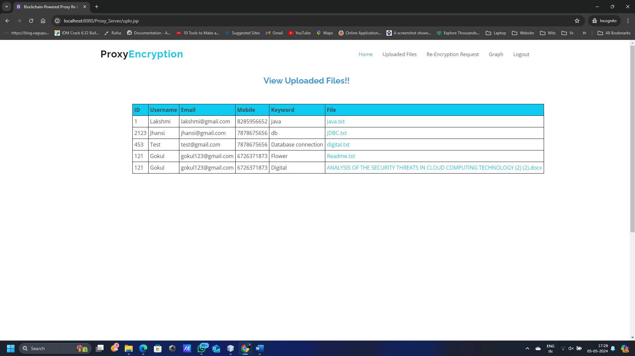

Slide 28
TESTING
Unit Testing Perspective:
We focus on testing individual units or components of the web application in isolation.
This involves testing functions, modules, or classes on both the backend and frontend.
Tools like Jest for JavaScript or PyTest for Python are commonly used for unit testing.
Each test typically involves arranging the necessary data or context, acting by invoking the specific function or method under test, and asserting that the result meets the expected outcome.
Integration Testing Perspective:
Our goal is to ensure that different parts of the application work together seamlessly.
This includes testing interactions between backend APIs and frontend components, database integrations, and third-party service integrations.
Tools like Selenium or Cypress are used for frontend integration testing, while frameworks like Flask (Python) or Express.js (JavaScript) provide tools for testing API integrations on the backend.
Integration tests involve setting up the environment, performing actions that simulate real-world usage scenarios, and verifying that the integrations function correctly.

Slide 29
CONCLUSION
The emergence of the IoT has made data sharing one of its most prominent applications. To guarantee data confidentiality, integrity, and privacy, we propose a secure identity-based PRE data-sharing scheme in a cloud computing environment.
Secure data sharing is realized with ABPRE technique, which allows the data owners to store their encrypted data in the cloud and share them with legitimate users efficiently. Due to resource constraints, an edge device serves as the proxy to handle the intensive computations.
Continuous network
Large server running capacity.
Required more number of Processing units.

Slide 30
Future Scope:
In features of ICN to proficiently deliver cached content, thereby improving the quality of service and making great use of the network bandwidth.
Then, we present a blockchain-based system model that allows for flexible authorization on encrypted data.

Slide 31
REFERENCES
[1] A. Al-Fuqaha, M. Guizani, M. Mohammadi, M. Aledhari, and M. Ayyash,“Internet of Things: A survey on enabling technologies, protocols, andapplications,” IEEE Commun. Surveys Tut.
[2] M. Blaze, G. Bleumer, and M. Strauss, “Divertible protocols and atomicproxy cryptography,” in Proc. Int. Conf. Theory Appl. CryptographicTechn., Springer.
[3] A. Shamir, “Identity-based cryptosystems and signature schemes,” in Proc. Workshop Theory Appl. Cryptographic Techn., Springer.

Slide 32
[4] D. Boneh, G. Di Crescenzo, R. Ostrovsky, and G. Persiano, “Publickey encryption with keyword search,” in Proc. Int. Conf. Theory Appl.Cryptographic Techn., Springer.
[5] B. R. Waters, D. Balfanz, G. Durfee, and D. K. Smetters, “Building anencrypted and searchable audit log.
[6] Alex Khang, Subrata Chowdhury - The Data-Driven Blockchain – CRC Press - 2018
[7] Yassine Maleh Mohammad Shojafar Mamoun Alazab Imed Romdhani – Blockchain for Cybersecurity and Privacy: Architectures, Challenges, and Applications – CRC Press 2018.

Slide 33
William Stallings - Cryptography and Network Security: Principles and Practice – Pearson - 2018
Chhagan Lal and Navin Rajpal - Internet of Things (IoT) Security Techniques and Frameworks - CRC Press - 2020.
Security Engineering: A Guide to Building Dependable Distributed Systems - Ross Anderson, published – 2008 - Wiley
Web Resources :
1. https://scholar.google.com/
2. https://www.wikipedia.org/
3. https://dl.acm.org/
4. ieee.org

